Slide 1
CSCI 566: Deep Learning and Its Applications
Jesse Thomason
Lecture 5: Recurrent Neural Networks

Slide 2
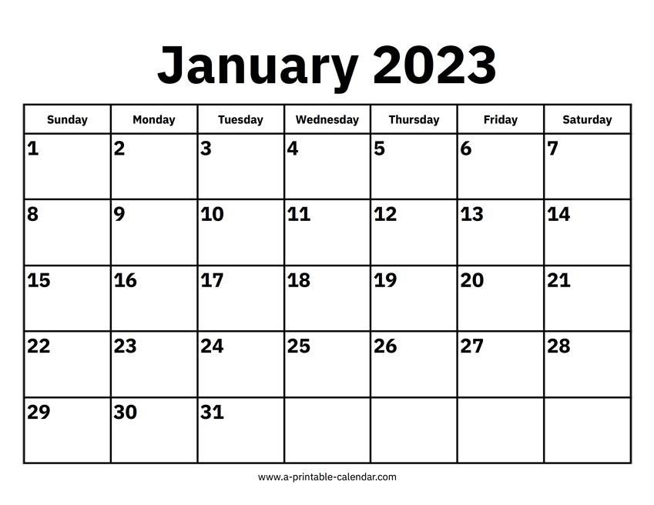
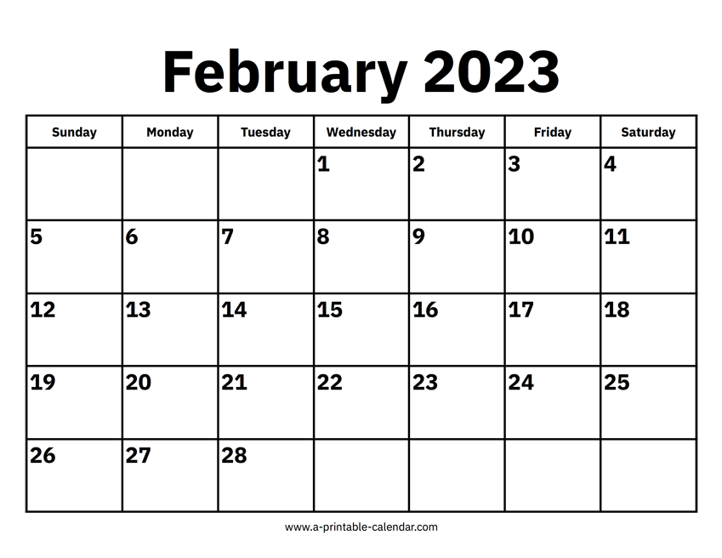

Map to the Midterm
Module 1: Neural Network Basics

Slide 3
[Feb 17] Wrapping Up Module One
Project Teams Formed | Feb 3
Assignment 1 Out | Feb 10
Project Proposal Due | Feb 17
Midterm Exam | Feb 24
Assignment 1 Due | Feb 27

Slide 4
Course Project Proposals Due Today
See Piazza for assignment description details; 10 slides addressing:
Q1: What will your project aim to do? Articulate your objectives using absolutely no jargon.
Q2: What is new in your approach and why do you think it will be successful?
Q3: Who cares? If you are successful, what difference will it make?
Q4: What are the risks?
Q5: How much will it cost?
Q6: Who will do what? Outline your expectations for your team to hold yourselves accountable to one another and to us.
Q7: What is your expected timeline?
The Heilmeier Catechism

Slide 5
Midterm Next Week [Feb 24]
The midterm exam will be conducted on Feb 24 during our class period after announcements (1:20pm to 4:20pm PT)
You do not need to be physically present to take the exam
The exam will be in the form of a link to a PDF (exam questions) and a link to a Google Form (to submit answers)
The exam will be partially or entirely multiple choice
The exam PDF and Google Form will be available only during the 1:20pm-4:20pm window; links will go up on Piazza
We are still working on the exam, but we do not expect it to take most people the full class period to complete.

Slide 6
In-class “Pop-up” Quizzes
These quizzes are a method of engaging with you while the class is happening
They account for a very small fraction of your total grade
There will probably be more than 5 of them
They can, generally, not be made up or postponed
If you usually attend class, this part of your evaluation will just be totally fine
Deliverable | Points of the total grade
Pop-up Quizzes | 5
… | …
TOTAL | 100

Slide 7
Overview of Today’s Plan
Course organization and deliverables
Any questions before we move on?
Recurrent Neural Networks
Long-Short Term Memory
Applications and Attention Mechanisms

Slide 8
Activation Functions
ɸ_{x}(x)=x
Wx
Wx+b
a(Wx+b)
b₁

Slide 9
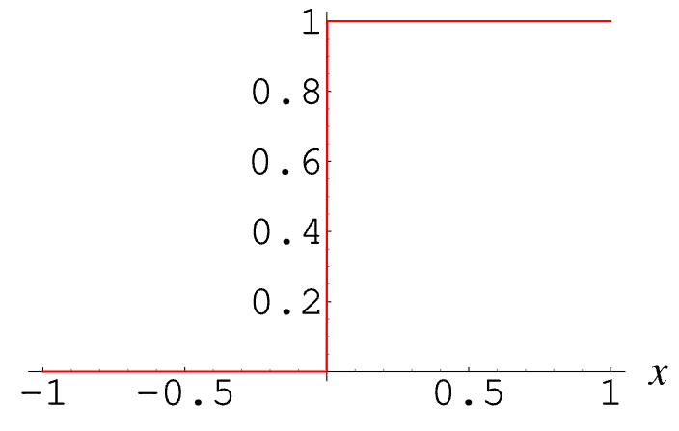
Activation Functions
ɸ_{x}(x)=x
Wx
Wx+b
a(Wx+b)
= a(W_{1,1}x₁ + W_{1,2}x₂ + W_{1,3}x₃ + W_{1,4}x₄ + W_{1,5}x₅+b₁)
If we think about a “neuron” as inspiration, the output after a should be 1 if W_{1,1}x₁ + W_{1,2}x₂ + W_{1,3}x₃ + W_{1,4}x₄ + W_{1,5}x₅+b₁ exceeds a threshold and 0 else.
What’s the “problem” with defining a this way?
b₁
e.g., a(x) = {1 if x>0 else 0}
To perform backpropagation, we need differentiable functions with non-zero gradients.

Slide 10
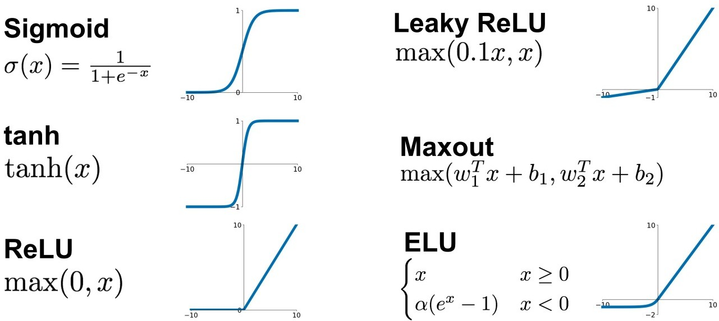
Activation Functions

Slide 11
f: X ✕ Θ → Y;
f(x;θ)=y; θ∈Θ for model M
f: X → Y;
f(x)=y
f: ɸ_{x}(X) ✕ Θ → ɸ_{y}(Y);
f(x;θ)=y
f: ɸ_{x}(X) → ɸ_{y}(Y);
f(x)=y
DL enables function approximation for f and is constrained by:
Data representation ɸ
Model architecture M
Loss function L
Optimization algorithm
Training data D
θ*=min_{θ∈Θ}(Σ_{(x,y)}L(f(x;θ), y)))
θ*=min_{θ∈Θ}(Σ_{(x,y)∈D}L(f(x;θ), y)))

Slide 12
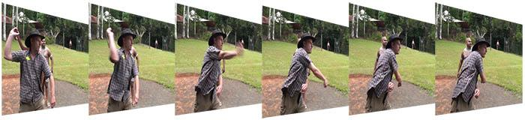
Video Topic Classification
Sports
Input space X?
Images at every timestep
ɸ_{x}(X)=R^{T,W,H,3}
Output space Y?
Output classes C
X=C
Would a CNN make sense here?
3D CNN
Where would filters that span the time dimension fail?
What if we processed every frame with a 2D CNN?
Would need some method to aggregate through time.

Slide 13
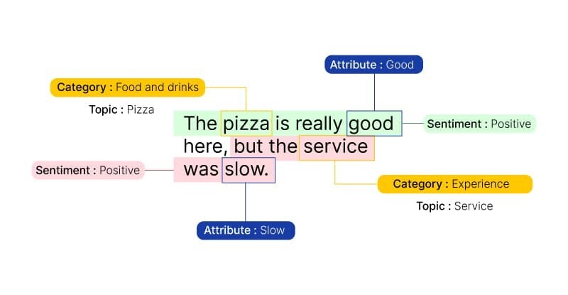
Text Classification
Input space X?
Review tokens T
X=T^{N} for max length N
Output space Y?
Possible sentiments S
Y=S
Classification via a multi-layer perceptron:
Represent x as a multi-hot “bag of words” vector that tells us which words are in the review and which aren’t
Weaknesses of an MLP model?
No ordering information
“cold ice cream and warm pizza”
“warm ice cream and cold pizza”

Slide 14
Text Classification
Input space X?
Review tokens T
X=T^{N} for max length N
Output space Y?
Possible sentiments S
Y=S
Classification via a CNN
Represent x as a sequence of token embedding vectors
Filters can combine words close together
Weaknesses?
Words may have long-range dependencies that are hard to see with CNNs that favor neighborhood information
E.g., Main verb of “The horse raced past the barn fell”?

Slide 15
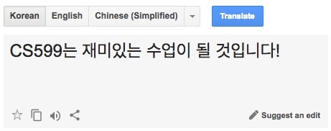
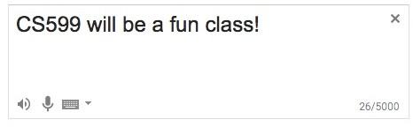
Machine Translation
Input space X?
Input tokens T
X=T^{N} for max length N
Output space Y?
Output tokens V
X=V^{N} for max length M
Would an MLP even make sense here?
What would our output classification be?
Would a CNN even make sense here?
What might the output architecture look like?
Probably we need an entirely different approach!

Slide 16

Classes of Sequence-to-Sequence Problems
One-to-one
One input produces one output
Image classification
y
h
Person
x

Slide 17
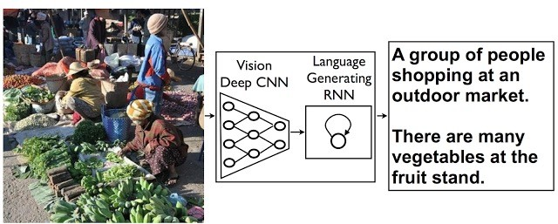
Classes of Sequence-to-Sequence Problems
One-to-many
One input produces a sequence of outputs
Image captioning
y₁
y₂
y₃
y₄
y₅
y_{n}
h₁
h₂
h₃
h₄
h₅
…
h_{n}
x

Slide 18
Classes of Sequence-to-Sequence Problems
Many-to-one
Sequence of inputs produces a single output
Text classification
y
h₁
h₂
h₃
h₄
h₅
…
h_{n}
x₁
x₂
x₃
x₄
x₅
x_{n}

Slide 19
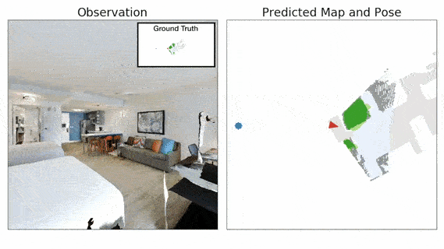
Classes of Sequence-to-Sequence Problems
Many-to-many
A sequence of inputs produces a sequence of outputs
Robot Actions
y₁
y₂
y₃
y₄
y₅
y_{n}
h₁
h₂
h₃
h₄
h₅
…
h_{n}
x₁
x₂
x₃
x₄
x₅
x_{n}

Slide 20
Classes of Sequence-to-Sequence Problems
Many-to-many variants:
Sequential one-to-one
Robot actions
Encoder-decoder
Machine Translation
y₁
y₂
y₃
y₄
y₅
y₁
y₂
Encoder Network
h₁
h₂
h₃
h₄
h₅
h₁
h₂
h₃
Decoder Network
h₄
h₅
x₁
x₂
x₃
x₄
x₅
x₁
x₂
x₃

Slide 21
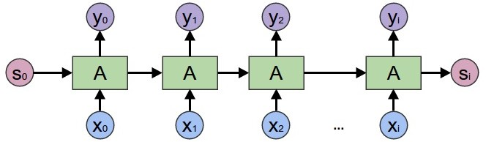
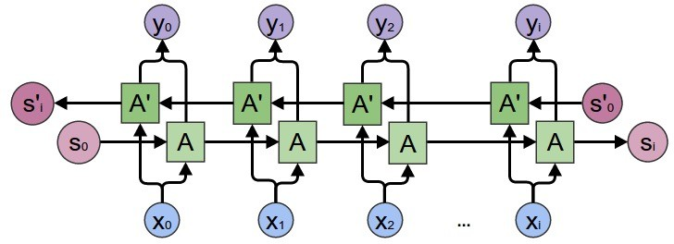
Unidirectional and Bidirectional Seq2Seq Models
Forward RNN
Bidirectional RNN
Output y_{t} depends only on inputs so far x_{0:t-1}
E.g., robot actions
Output y_{t} depends on all inputs x_{0:L}
E.g., machine translation

Slide 22
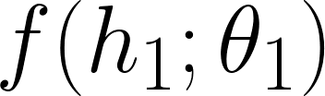
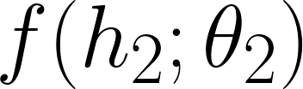
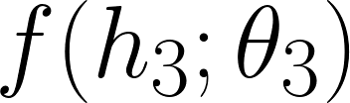
Sequence Modeling with Learned Neural Functions
What’s a weakness of this parameterization?
y₁
y₂
y₃
y₄
h₁
h₂
h₃
h₄
x

Slide 23
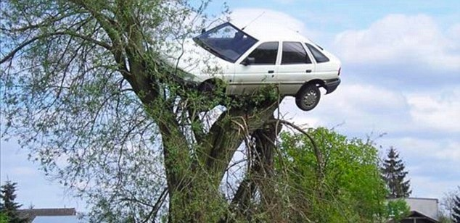
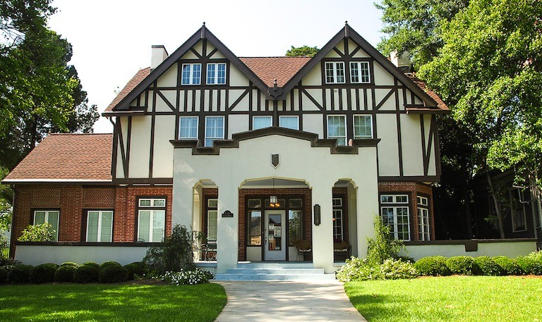
Sequence Modeling with Learned Neural Functions
A
big
house
A
car
on
a
tree
y1
y2
y3
y1
y2
y3
y4
y5
h1
h2
h3
h1
h2
h3
h4
h5
x
x

Slide 24
Sequence Modeling with Learned Neural Functions
A
big
house
A
car
on
a
tree
y1
y2
y3
y1
y2
y3
y4
y5
How might we account for variable length input and output in our model design?
h1
h2
h3
h1
h2
h3
h4
h5
x
x

Slide 25
Sequence Modeling with Learned Neural Functions
y₁
y₂
y₃
y₄
h₁
h₂
h₃
h₄
We can learn functions: f: h->h f: x->h f: h->y That are each independent of the timestep dimension.
x

Slide 26
Recurrent Neural Networks
We encode one input at a time to iteratively build up our representation of the sequence
After each new input, we produce a new hidden state from which we could decode outputs (e.g., many-to-many)
For classification (e.g., many-to-one), we can decode from the final hidden state that contains information about the whole input sequence
We only need to learn how to map inputs to hidden states, hidden states to outputs, and hidden states to hidden states

Slide 27
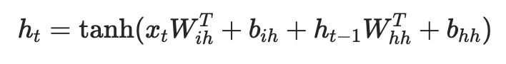
Text Classification with a Recurrent Neural Network
“Logits” for each of the |C| class labels
Fully Connected Layer F(h_{n})
RNN hidden state h
RNN
RNN
…
RNN
Embeddings E(t)
Embedding Layer E(t)
Token id t:
1
320
253
281
6
0
287
4
Word-level
served
cold
ice
cream
and
warm
pizza
.

Slide 28
NLP FUNDAMENTALS: Word Embeddings
A word embedding is a fixed-length vector representation of a given string, such as “dog”; we’ll say length h
Word embedding vectors stacked together as rows form a matrix of E^{|V|*h} for V the set of words the model can understand as input
That embedding matrix is differentiable and can be learned as part of our neural network architecture!
We will cover word embeddings in more detail in Module 2

Slide 29
Text Classification with a Recurrent Neural Network
“Logits” for each of the |C| class labels
Fully Connected Layer F(h_{n})
RNN hidden state h
RNN
RNN
…
RNN
Embeddings E(t)
Embedding Layer E(t)
Token id t:
1
320
253
281
6
0
287
4
Word-level
served
cold
ice
cream
and
warm
pizza
.

Slide 30
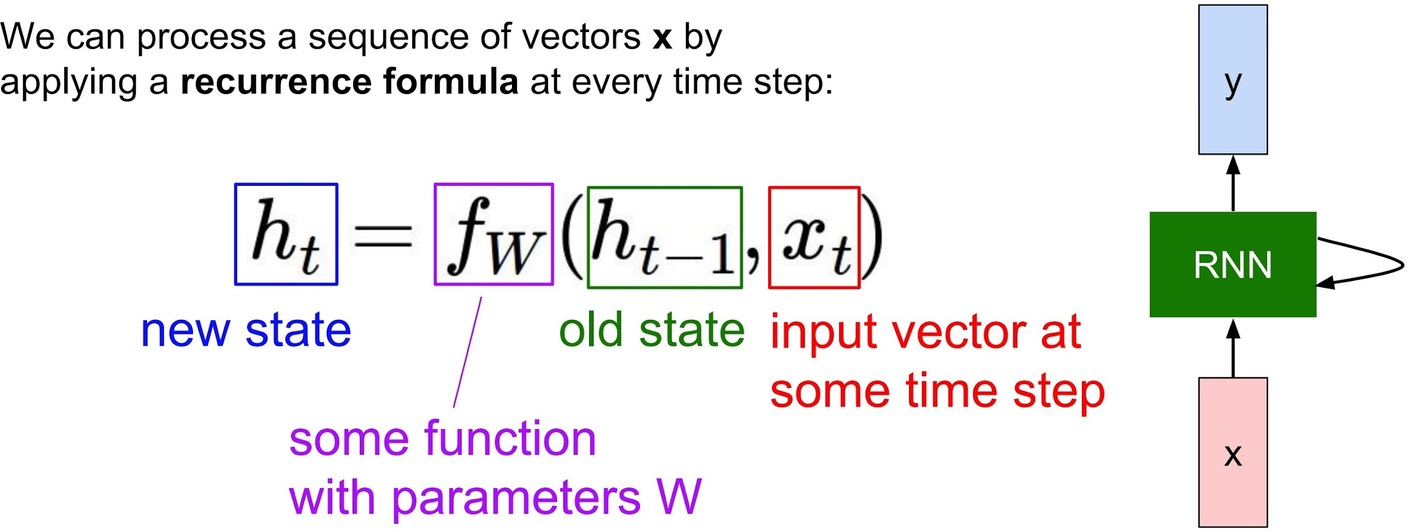
Recurrence In Neural Networks
We can process a sequence of inputs one input at a time by defining a recurrence function
Recurrence function takes two arguments: the next input and a state representing aggregated information from past inputs

Slide 31
Recurrence In Neural Networks
Remember how CNN filters were just little linear layers?
Same story for how we define f_{W}!
Vanilla RNN:
h_{t}=tanh(W_{h→h}h_{t-1}+W_{x→h}x_{t})
y_{t}=𝝈(W_{h→y}h_{t})
Note that to compress notation we frequently drop bias vectors.

Slide 32
High Level Computation Graph for RNN
l₁=L(y₁, *y₁)
l₂=L(y₂, *y₂)
l₃=L(y₃, *y₃)
y₁
y₂
y₃
y₁=𝝈(W_{h→y}h₁)
y₂=𝝈(W_{h→y}h₂)
y₃=𝝈(W_{h→y}h₃)
h₀
h₁
h₂
h₃
h₁=tanh(W_{h→h}h₀+W_{x→h}x₁)
h₂=tanh(W_{h→h}h₁+W_{x→h}x₂)
h₃=tanh(W_{h→h}h₂+W_{x→h}x₃)
x₁
x₂
x₃

Slide 33
Backpropagation for RNN
l₁=L(y₁, *y₁)
l₂=L(y₂, *y₂)
l₃=L(y₃, *y₃)
y₁
y₂
y₃
y₁=𝝈(W_{h→y}h₁)
y₂=𝝈(W_{h→y}h₂)
y₃=𝝈(W_{h→y}h₃)
h₀
h₁
h₂
h₃
h₁=tanh(W_{h→h}h₀+W_{x→h}x₁)
h₂=tanh(W_{h→h}h₁+W_{x→h}x₂)
h₃=tanh(W_{h→h}h₂+W_{x→h}x₃)
x₁
x₂
x₃

Slide 34
Backpropagation for RNN
We learn functions: f: h->h f: x->h f: h->y That are each independent of the timestep dimension.
l₁=L(y₁, *y₁)
l₂=L(y₂, *y₂)
l₃=L(y₃, *y₃)
y₁
y₂
y₃
y₁=𝝈(W_{h→y}h₁)
y₂=𝝈(W_{h→y}h₂)
y₃=𝝈(W_{h→y}h₃)
h₀
h₁
h₂
h₃
h₁=tanh(W_{h→h}h₀+W_{x→h}x₁)
h₂=tanh(W_{h→h}h₁+W_{x→h}x₂)
h₃=tanh(W_{h→h}h₂+W_{x→h}x₃)
x₁
Losses are aggregated (summed) across timesteps.
x₂
x₃

Slide 35
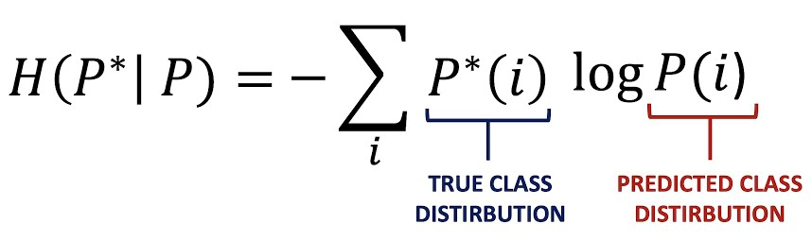
Backpropagation for RNNs
But we… don’t use RNNs?
I know Transformers are all the rage, but even when RNNs were common we stopped using vanilla RNNs. Why?
Let’s look at our gradient step again:
θ := θ - ε∇_{di…dj} L[M(ɸ(d), θ)]
Need the derivative of, in this example, cross entropy
So L is H(P*|P)
P(i) = M(ɸ(d), θ)
M is our fancy new RNN

Slide 36
Text Classification with a Recurrent Neural Network
“Logits” for each of the |C| class labels
Fully Connected Layer F(h_{n})
RNN hidden state h
RNN
RNN
…
RNN
Embeddings E(t)
Embedding Layer E(t)
Token id t:
1
320
253
281
6
0
287
4
Word-level
served
cold
ice
cream
and
warm
pizza
.

Slide 37
The Slide Where RNNs Lose
P(i) = M(ɸ(d), θ); R the RNN layer we’re learning
… E(t₁)...E(t_{L}) ….
… R(E(t₁), 0) …
… R(E(t₂), R(E(t₁), 0)) …
… R(E(t_{L}), … R(E(t₄), R(E(t₃), R(E(t₂), R(E(t₁), 0))))...) …
P(i) = F(R(E(t_{L}), … R(E(t₄), R(E(t₃), R(E(t₂), R(E(t₁), 0))))...))
Just thinking about the size of ∇, it’ll be biggest at F
For every nested call to R, the gradient vanishes further; remember that we’re non-linearly squeezing with each R too
https://en.wikipedia.org/wiki/Vanishing_gradient_problem

Slide 38
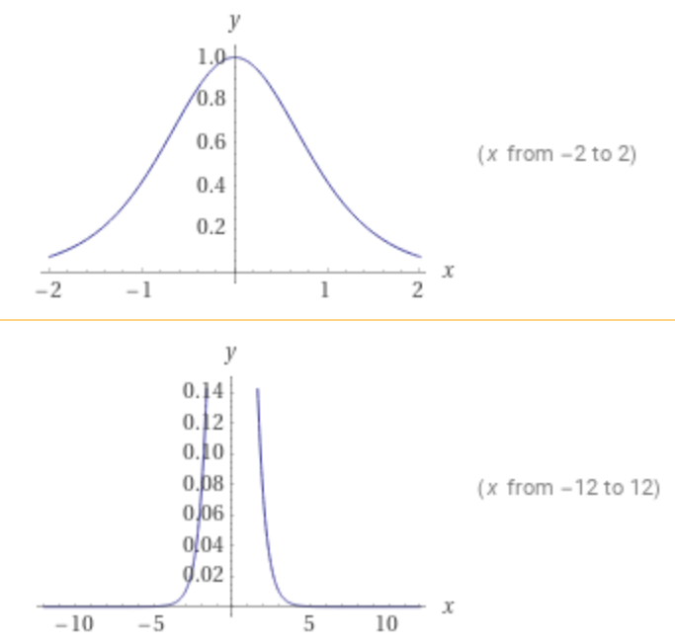
The Vanishing Gradient Problem
l₁=L(y₁, *y₁)
l₂=L(y₂, *y₂)
l₃=L(y₃, *y₃)
y₁
y₂
y₃
^{d}/_{dx}tanh(x) = sech²(x)
y₁=𝝈(W_{h→y}h₁)
y₂=𝝈(W_{h→y}h₂)
y₃=𝝈(W_{h→y}h₃)
h₀
h₁
h₂
h₃
h₁=tanh(W_{h→h}h₀+W_{x→h}x₁)
h₂=tanh(W_{h→h}h₁+W_{x→h}x₂)
h₃=tanh(W_{h→h}h₂+W_{x→h}x₃)
x₁
x₂
x₃

Slide 39
The Vanishing Gradient Problem
l₁=L(y₁, *y₁)
l₂=L(y₂, *y₂)
l₃=L(y₃, *y₃)
y₁
y₂
y₃
y₁=𝝈(W_{h→y}h₁)
y₂=𝝈(W_{h→y}h₂)
y₃=𝝈(W_{h→y}h₃)
h₀
h₁
h₂
h₃
h₁=tanh(W_{h→h}h₀+W_{x→h}x₁)
h₂=tanh(W_{h→h}h₁+W_{x→h}x₂)
h₃=tanh(W_{h→h}h₂+W_{x→h}x₃)
As gradient vanishes, we waste computation going this far back in time…
x₁
x₂
x₃

Slide 40
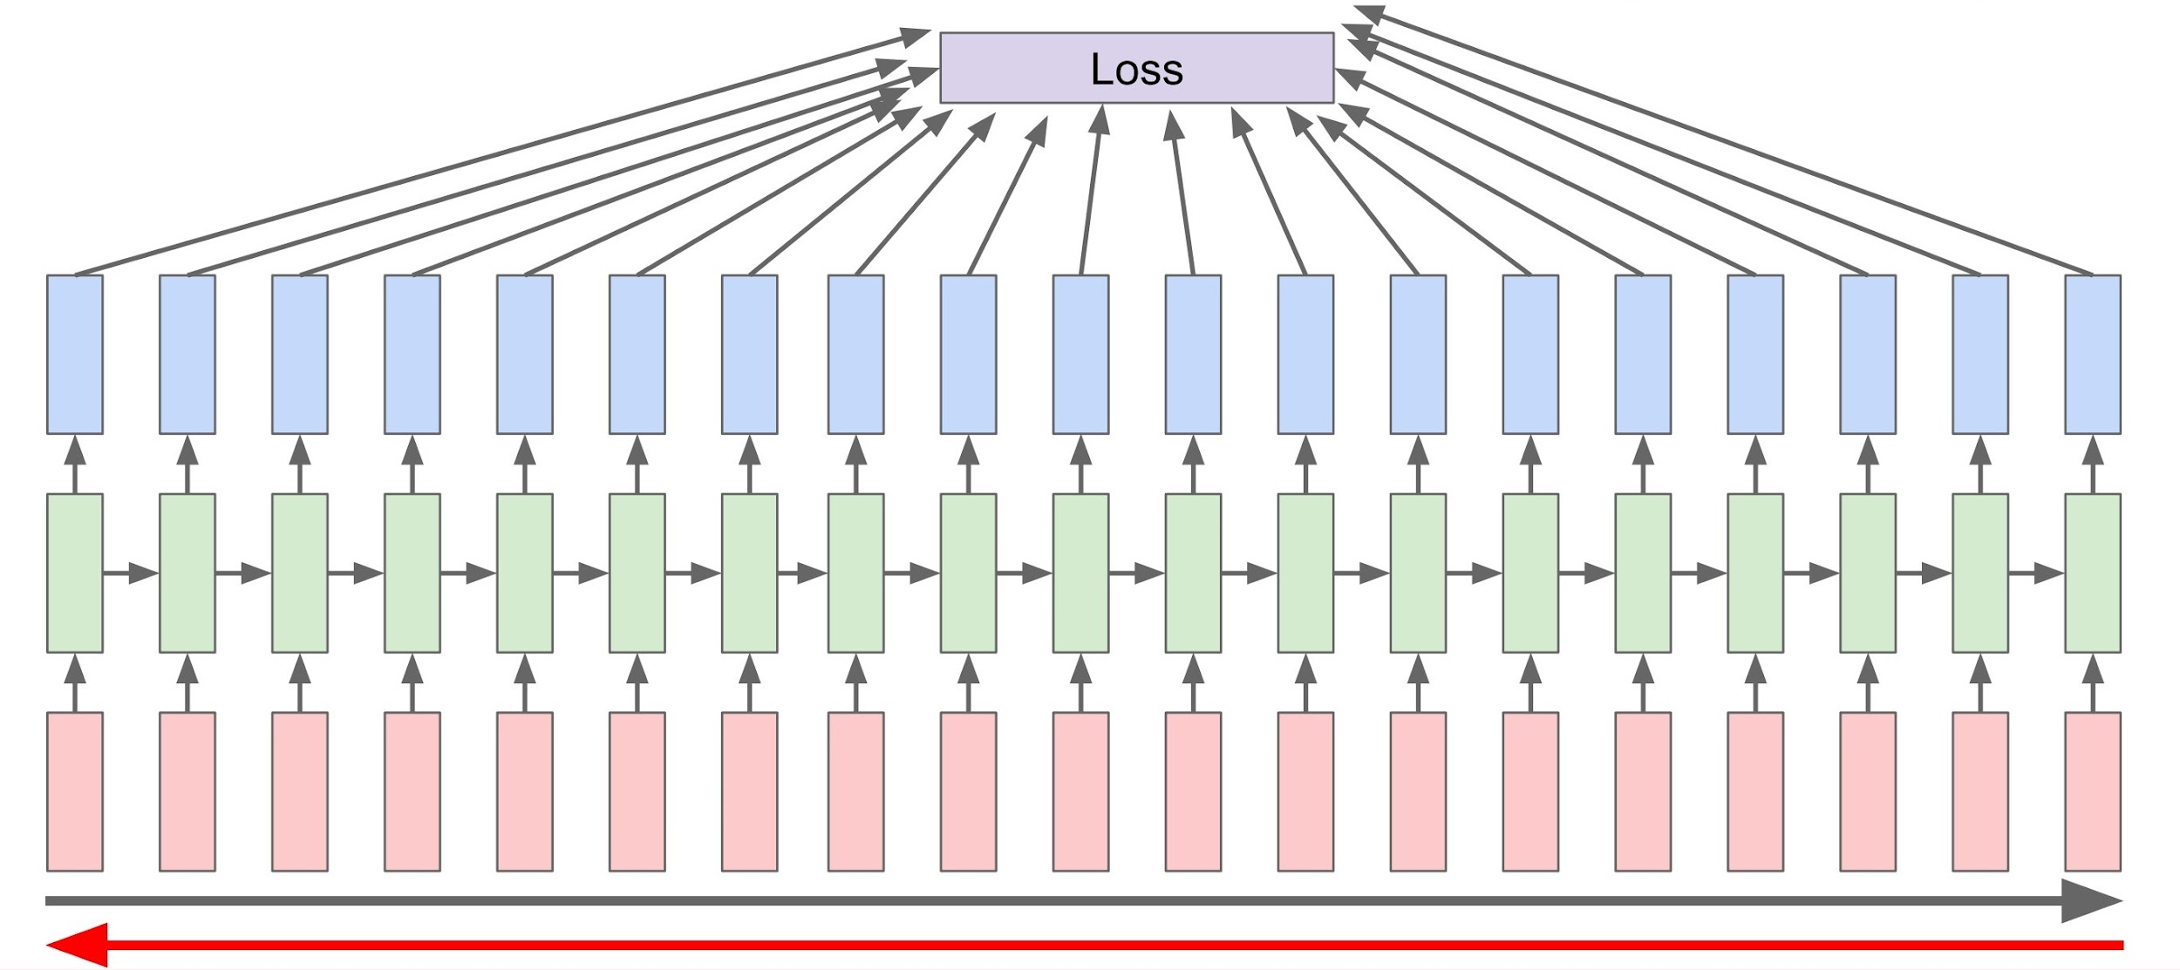
The Vanishing Gradient Problem

Slide 41
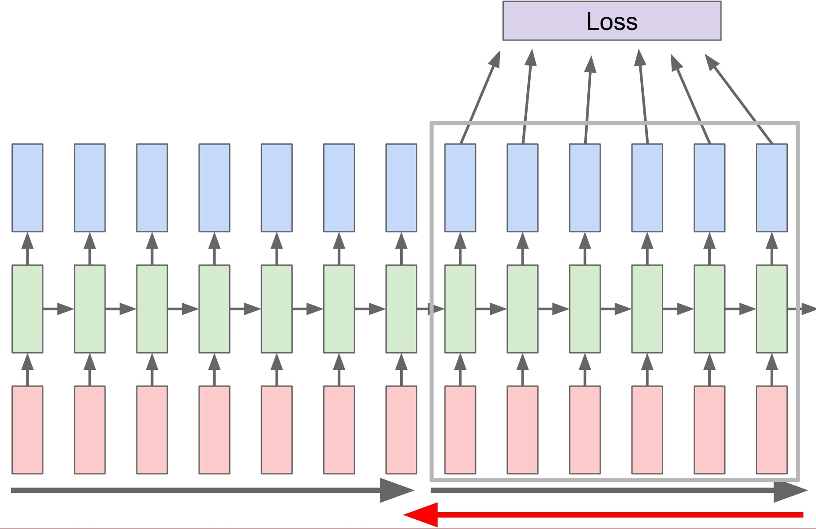
Truncated Backpropagation
Run forward and backward through chunks of the sequence instead of the whole sequence
Carry hidden states forward through chunks
Truncate backprop after a few steps

Slide 42
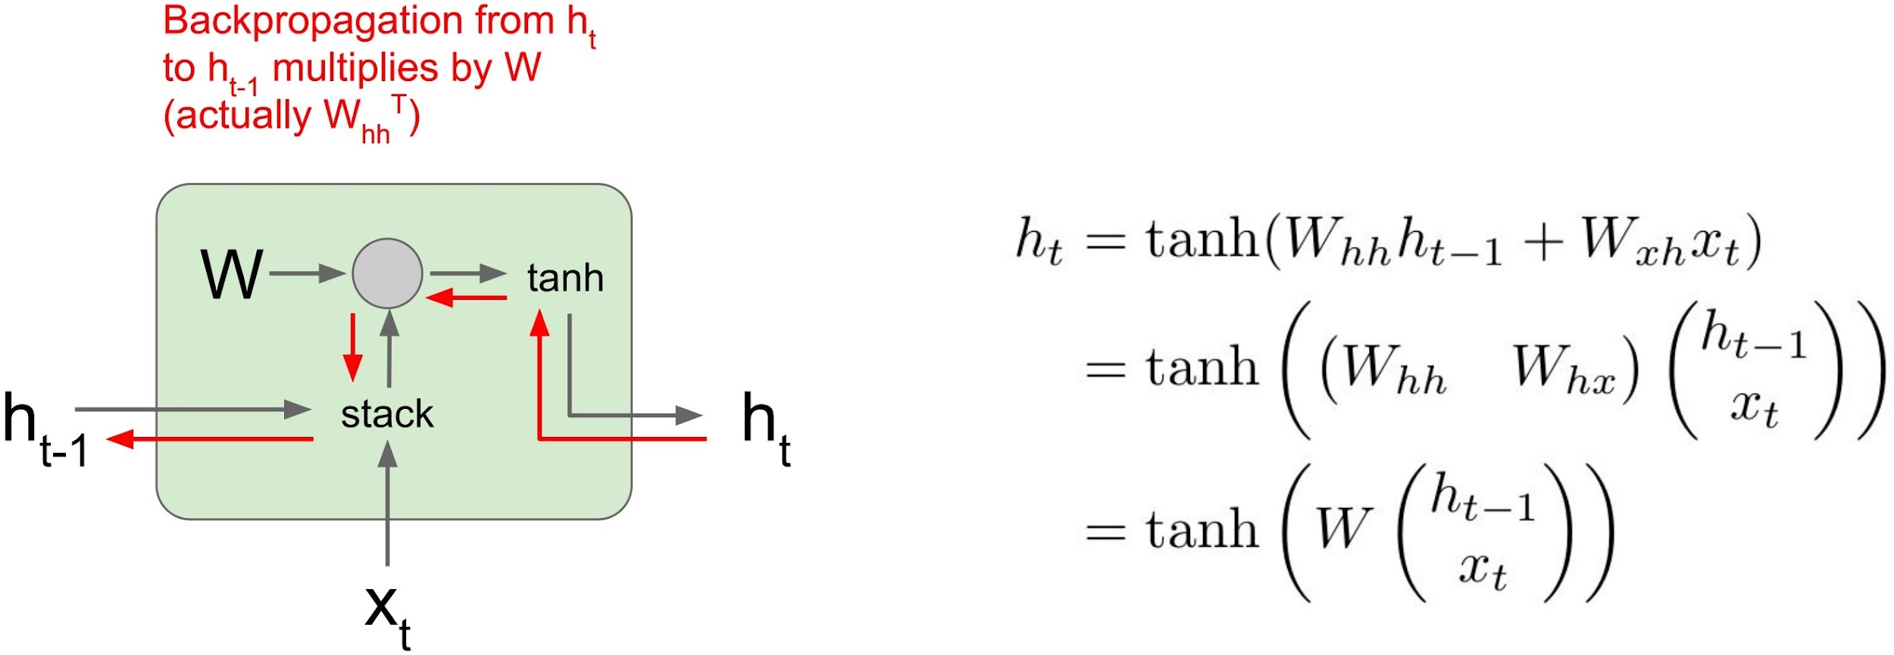
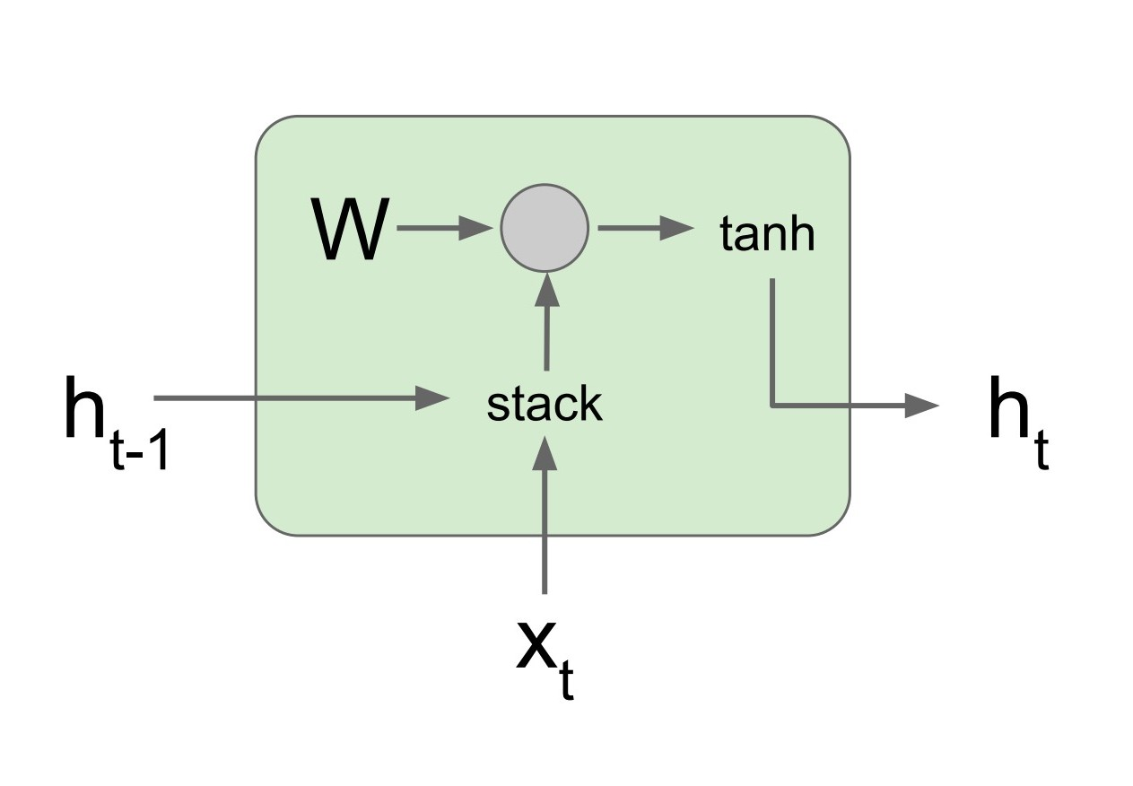
The Vanishing Gradient Problem
RNN Cell

Slide 43
The Vanishing Gradient Problem

Slide 44
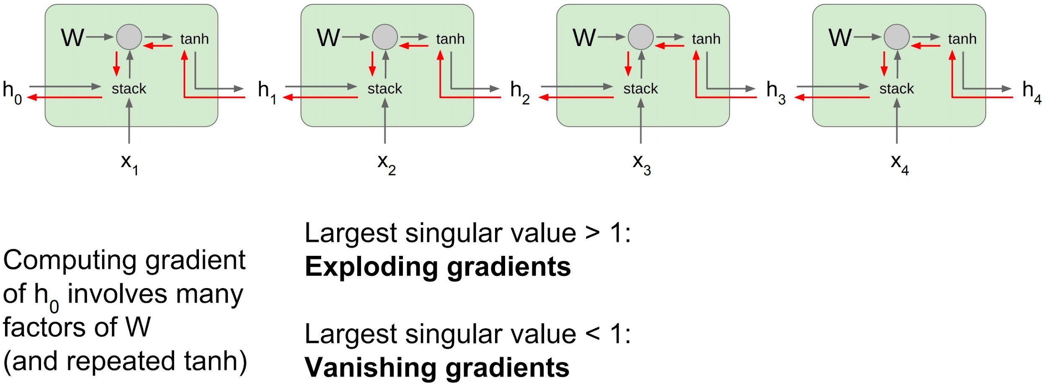


The Vanishing Gradient Problem
Gradient clipping: scale gradient if its norm is too big
To not squash downstream gradients, we need a new architecture.

Slide 45
Overview of Today’s Plan
Course organization and deliverables
Recurrent Neural Networks
Any questions before we move on?
Long-Short Term Memory
Applications and Attention Mechanisms

Slide 46
Long short-term memory
A dumb name for some complex cell architecture
The details of LSTMs have taken a backseat in NLP lately
Upshot: preserve more gradient by keeping more of the hidden state around between updates
Gated Recurrent Units (GRU) are in the same family of attempts to get around this issue with sequence problems
In many settings, the lower parameter count of LSTMs and GRUs makes them preferable to Transformers
So we will still learn LSTMs!
https://en.wikipedia.org/wiki/Vanishing_gradient_problem

Slide 47
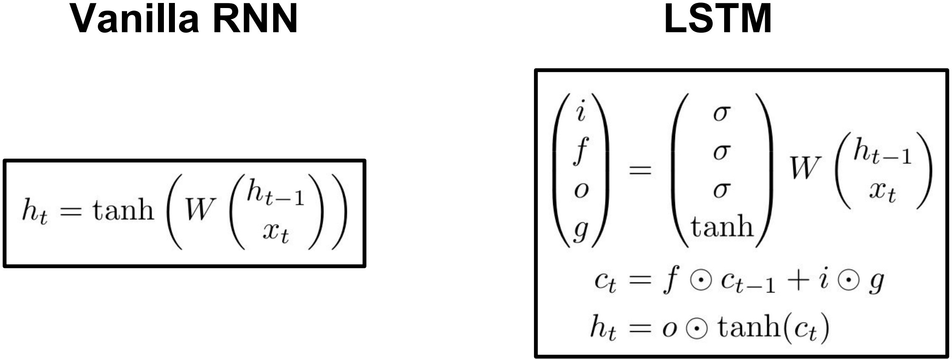
Long short-term memory
Intuition of LSTMs is to “flip” the default recurrence behavior from “squeeze out the history” to “mostly consider the history”
Hochreiter and Schmidhuber, “Long Short Term Memory”, Neural Computation 1997

Slide 48
Long short-term memory
ℎ
[
𝑡−1
]
𝑖 = 𝜎(𝑊
)
)
)
𝑖
𝑥_{𝑡}
ℎ
[
𝑡−1
]
𝑓 = 𝜎(𝑊
𝑓
𝑥_{𝑡}
ℎ
[
𝑡−1
]
𝑜 = 𝜎(𝑊
𝑜
𝑥_{𝑡}
ℎ
𝑔 = tanh(𝑊
[
𝑡−1
]
)
g
𝑥_{𝑡}
Hochreiter and Schmidhuber, “Long Short Term Memory”, Neural Computation 1997

Slide 49
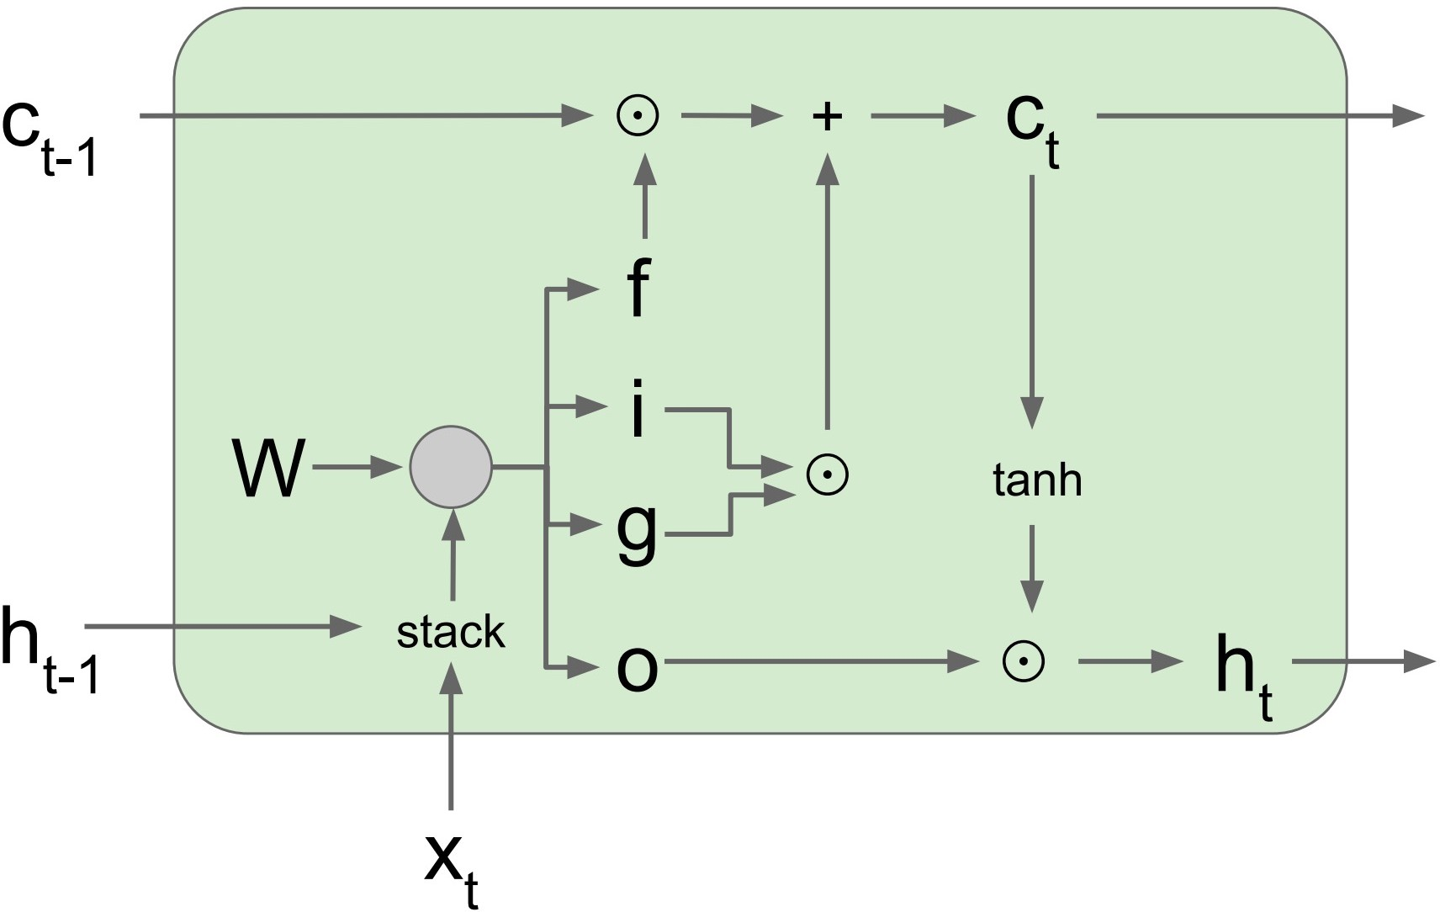
Long short-term memory
LSTM Cell
Latent vectors f, i, g and o are each learned transformations of h_{t-1} and x_{t}

Slide 50
Long short-term memory
LSTM Cell
Hidden state h_{t} is a function of both (x_{t},h_{t-1}) and cell state c_{t}. The cell state holds long-term information.

Slide 51
Long short-term memory
LSTM Cell
Backprop from c_{t} to c_{t-1} is elementwise multiplication by f, not a matrix multiply; no additional non-linearities.

Slide 52
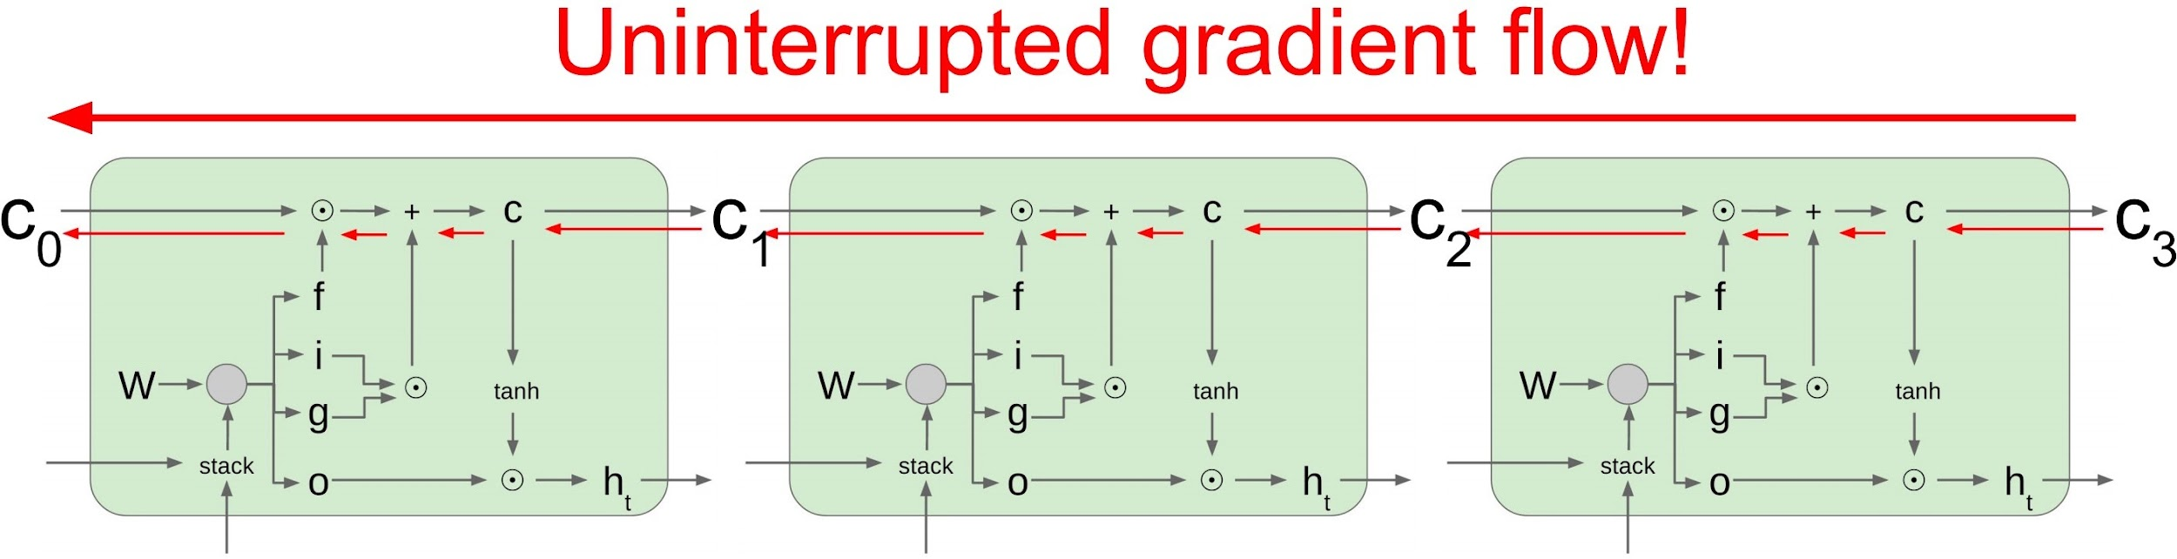
Long short-term memory

Slide 53
Long short-term memory
)
ℎ
[
𝑡−1
]
LSTM Cell
𝑓 = 𝜎(𝑊
𝑓
𝑥_{𝑡}
Forget gate (f): h_{t-1} and x_{t} tell us what about previous cell state to downweight for c_{t}; sigmoid activation.

Slide 54
Long short-term memory
𝑔 = tanh(𝑊
[
𝑡−1
]
)
)
g
𝑥_{𝑡}
ℎ
[
𝑡−1
]
LSTM Cell
i = 𝜎(𝑊
i
𝑥_{𝑡}
Gate gate (g): What information from h_{t-1} and x_{t} to add to c_{t} (tanh).
Input gate (i): How much information to add to c_{t} (sigmoid).

Slide 55
Long short-term memory
)
ℎ
[
𝑡−1
]
LSTM Cell
o = 𝜎(𝑊
o
𝑥_{𝑡}
Output gate (o): h_{t-1} and x_{t} tell us what new information should go into the output; joined with cell state for h_{t}

Slide 56
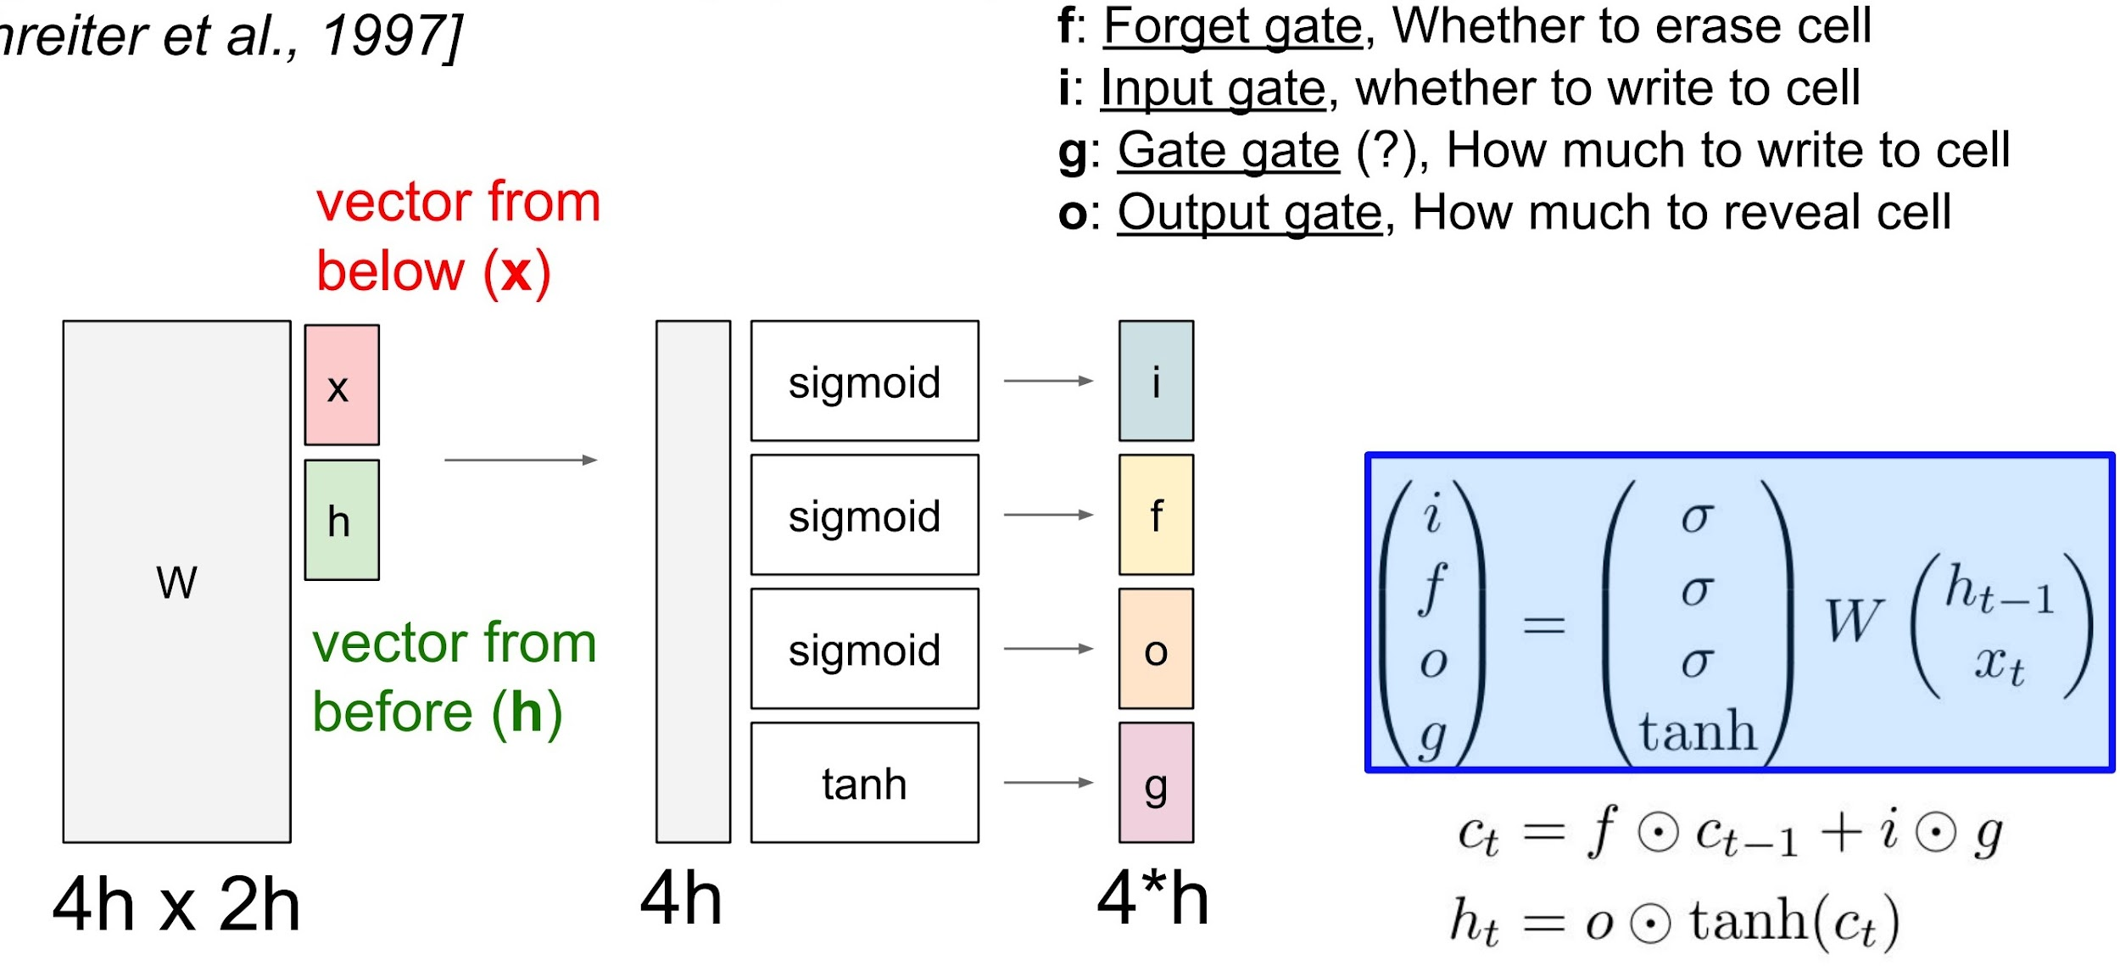
Long short-term memory

Slide 57
Text Classification with an LSTM
“Logits” for each of the |C| class labels
Fully Connected Layer F(h_{n})
LSTM hidden and cell states h, c
LSTM
LSTM
…
LSTM
Embeddings E(t)
Embedding Layer E(t)
Token id t:
1
320
253
281
6
0
287
4
Word-level
served
cold
ice
cream
and
warm
pizza
.

Slide 58
Text Classification with a Multi-Layer LSTM
“Logits” for each of the |C| class labels
Fully Connected Layer F(h_{n})
LSTM hidden and cell states h, c
LSTM
LSTM
…
LSTM
LSTM hidden and cell states h, c
LSTM
LSTM
…
LSTM
Embeddings E(t)
Embedding Layer E(t)
Token id t:
1
320
253
281
6
0
287
4
Word-level
served
cold
ice
cream
and
warm
pizza
.

Slide 59
Text Classification with a Multi-Layer LSTM
“Logits” for each of the |C| class labels
Fully Connected Layer F(h_{n})
LSTM hidden and cell states h, c
What would happen if we applied multiple vanilla RNN layers?
LSTM
LSTM
…
LSTM
LSTM hidden and cell states h, c
LSTM
LSTM
…
LSTM
Embeddings E(t)
Embedding Layer E(t)
Token id t:
1
320
253
281
6
0
287
4
Word-level
served
cold
ice
cream
and
warm
pizza
.

Slide 60
Addressing the Vanishing Gradient Problem
What do you need to know?
LSTMs > vanilla RNNs basically all the time
Multi-layer LSTM makes sense; multi-layer vanilla RNN will have such bad gradient vanishing it probably won’t train
LSTMs ~= GRUs; think of this choice as a hyperparameter you can tune on your validation data
Using an RNN/LSTM/GRU is different from using convolutional layers to process text (e.g., short segments combined with some kind of pooling layer)

Slide 61
Overview of Today’s Plan
Course organization and deliverables
Recurrent Neural Networks
Long-Short Term Memory
Any questions before we move on?
Applications and Attention Mechanisms

Slide 62
Recurrent Neural Network Applications
Image Captioning
Question Answering
Visual Question Answering
Speech Recognition
Action Recognition in Videos
Text Parsing
Machine Translation
Genomic Sequence Classification

Slide 63
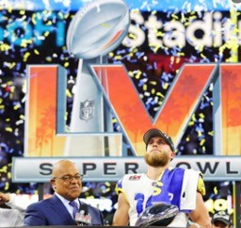

Image Captioning with Sequential Decoder
A football player receives an award.

Slide 64

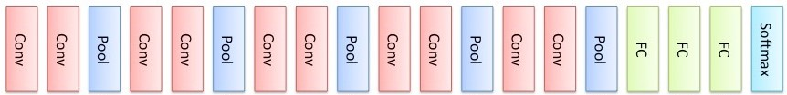
Image Captioning with Sequential Decoder
a
football
player
receives
an
award
<EOS>
y₁
y₂
y₃
y₄
y₅
y₆
y₇
h₀
h₁
h₂
h₃
h₄
h₅
h₆
h₇
x₁
x₂
x₃
x₄
x₅
x₆
x₇

Slide 65
Question Answering with Encoder-Decoder
Text
Mary moved to the bathroom.
John went to the hallway.
Question
Answer
Where is Mary?
bathroom

Slide 66
Question Answering with Encoder-Decoder
Text
Mary moved to the bathroom.
John went to the hallway.
T
Text embedding
Question
Q
Where is Mary?
Question embedding

Slide 67
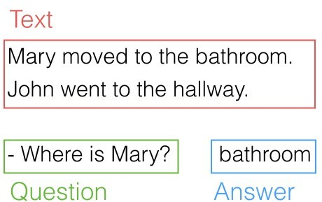
Question Answering with Encoder-Decoder
Text embedding
T
h1
h2
h3
h4
h5
…
h11
h12
x1
x2
x3
x4
x5
x11
x12
Mary
moved
to
the
bathroom
hallway
.

Slide 68
Question Answering with Encoder-Decoder
Question embedding
Q
h1
h2
h3
h4
x1
x2
x3
x4
Where
is
Mary
?

Slide 69
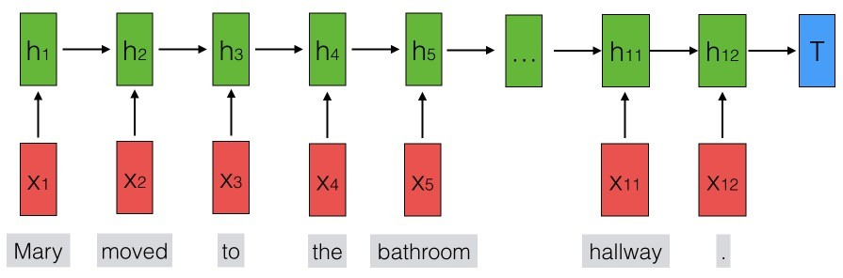
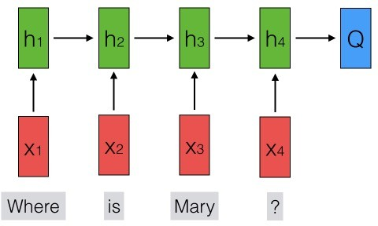
Question Answering with Encoder-Decoder
Answer
y
NN
Bathroom

Slide 70
Machine Translation and The Case for Contextual Info
893
489
998
شجرتان
shajaratan
تتمايلان
tatamayalan
<E>
s(h_{d})
s(h_{d})
s(h_{d})
Decoder D hidden state h_{d}
RNN
RNN
RNN
RNN
RNN
RNN
RNN
RNN
Embedding Layer V_{d}(t)
999
893
489
<S>
شجرتان
shajaratan
تتمايلان
tatamayalan
Embedding Layer V_{e}(t)
999
128
137
783
998
<S>
two
trees
sway
<E>

Slide 71
The Case for Contextual Information
English to Arabic translation
Arabic has a few things English doesn’t have, including the dual case, a noun- and verb- form for pairs
A tree sways
شجرة تتأرجح [shajarat tata'arjah]
Two trees sway
شجرتان تتمايلان [shajaratan tatamayalan]
The trees sway
الأشجار تتأرجح [al'ashjar tata'arjah]

Slide 72
Machine Translation and The Case for Contextual Info
893
شجرتان
shajaratan
s(h_{d})
Decoder D hidden state h_{d}
RNN
RNN
RNN
RNN
RNN
RNN
Embedding Layer V_{d}(t)
999
<S>
Embedding Layer V_{e}(t)
999
128
137
783
998
<S>
two
trees
sway
<E>

Slide 73
Use Attention to Rewrite RNN State Input
∈R
893
a=FC(h_{d1},h_{ei})
شجرتان
shajaratan
Σ_{i=1…L}h_{ei}exp(a(h_{d1},h_{ei}))
s(h_{d})
Init decoder D hidden state h_{d1}=h_{eN}
[Σ_{j=1…L}exp(a(h_{d1},h_{ej}))]
RNN
RNN
RNN
RNN
RNN
RNN
RNN
Embedding Layer V_{d}(t)
999
<S>
Embedding Layer V_{e}(t)
999
128
137
783
998
<S>
two
trees
sway
<E>

Slide 74
Attention
893
شجرتان
shajaratan
Σ_{i=1…L}h_{ei}exp(a(h_{d1},h_{ei}))
s(h_{d})
[Σ_{j=1…L}exp(a(h_{d1},h_{ej}))]
RNN
RNN
RNN
RNN
RNN
RNN
Embedding Layer V_{e}(t)
999
128
137
783
998
a=FC(h_{d1},h_{e1})
a=FC(h_{d1},h_{e2})
a=FC(h_{d1},h_{e3})
a=FC(h_{d1},h_{e4})
a=FC(h_{d1},h_{e5})
<S>
two
trees
sway
<E>

Slide 75
Attention
893
شجرتان
shajaratan
Σ_{i=1…L}h_{ei}exp(a(h_{d1},h_{ei}))
s(h_{d})
[Σ_{j=1…L}exp(a(h_{d1},h_{ej}))]
RNN
RNN
RNN
RNN
RNN
RNN
e
e
e
e
e
Σ
e
Σ
e
Σ
e
Σ
e
Σ
e
Embedding Layer V_{e}(t)
999
128
137
783
998
a=FC(h_{d1},h_{e1})
a=FC(h_{d1},h_{e2})
a=FC(h_{d1},h_{e3})
a=FC(h_{d1},h_{e4})
a=FC(h_{d1},h_{e5})
<S>
two
trees
sway
<E>

Slide 76
Encoder-Decoder Attention
The final hidden state of an encoder may not carry enough information about previous tokens to perform decoding
Attention reweights encoder states h_{e[1:L]} as a function of the decoder hidden state h_{d[t-1]} at each timestep
h_{d[t]}=[Σ_{i=1…L}h_{e[i]}exp(a(h_{d[t-1]},h_{e[i]})) ] / [Σ_{j=1…L}exp(a(h_{d[t-1]},h_{e[j]}))]
A learned attention head determines the matching score between the decoder’s last output state and each candidate encoder hidden state
An attention head has shared weights for all encoder states, so it’s cheap to add, parameter-wise

Slide 77
Encoder-Decoder Attention
893
شجرتان
shajaratan
∈R
s(h_{d})
a=FC(h_{d1},h_{ei})
RNN
RNN
RNN
RNN
RNN
RNN
Embedding Layer V_{d}(t)
999
<S>
Embedding Layer V_{e}(t)
999
128
137
783
998
<S>
two
trees
sway
<E>

Slide 78
Encoder-Decoder Attention
893
489
شجرتان
shajaratan
تتمايلان
tatamayalan
∈R
s(h_{d})
s(h_{d})
a=FC(h_{d2},h_{ei})
RNN
RNN
RNN
RNN
RNN
RNN
RNN
Embedding Layer V_{d}(t)
999
893
<S>
شجرتان
shajaratan
Embedding Layer V_{e}(t)
999
128
137
783
998
<S>
two
trees
sway
<E>

Slide 79
Encoder-Decoder Attention
893
489
998
شجرتان
shajaratan
تتمايلان
tatamayalan
<E>
∈R
s(h_{d})
s(h_{d})
s(h_{d})
a=FC(h_{d3},h_{ei})
RNN
RNN
RNN
RNN
RNN
RNN
RNN
RNN
Embedding Layer V_{d}(t)
999
893
489
<S>
شجرتان
shajaratan
تتمايلان
tatamayalan
Embedding Layer V_{e}(t)
999
128
137
783
998
<S>
two
trees
sway
<E>

Slide 80
Encoder-Decoder Attention
What are some pitfalls or weaknesses we can anticipate with the attention mechanism described so far?
Pitfalls:
We probably still don’t need the entire sequence for every decoding step
A lot of our weights will be near zero, probably
The shared parameters of the attention head might only learn to pick out certain dependencies (e.g., noun-verb agreement, determiner-gender agreement, …)

Slide 81
Encoder-Decoder Attention: Global Versus Local
We probably still don’t need the entire sequence for every decoding step
Can limit attention to a window of k around current decoding index to limit computation

Slide 82
Encoder-Decoder Attention: Global Versus Local
893
شجرتان
shajaratan
s(h_{d})
RNN
RNN
RNN
RNN
RNN
RNN
Embedding Layer V_{d}(t)
999
<S>
Embedding Layer V_{e}(t)
999
128
137
783
998
<S>
two
trees
sway
<E>

Slide 83
Encoder-Decoder Attention: Global Versus Local
893
489
شجرتان
shajaratan
تتمايلان
tatamayalan
s(h_{d})
s(h_{d})
RNN
RNN
RNN
RNN
RNN
RNN
RNN
Embedding Layer V_{d}(t)
999
893
<S>
شجرتان
shajaratan
Embedding Layer V_{e}(t)
999
128
137
783
998
<S>
two
trees
sway
<E>

Slide 84
Encoder-Decoder Attention: Global Versus Local
893
489
998
شجرتان
shajaratan
تتمايلان
tatamayalan
<E>
s(h_{d})
s(h_{d})
s(h_{d})
RNN
RNN
RNN
RNN
RNN
RNN
RNN
RNN
Embedding Layer V_{d}(t)
999
893
489
<S>
شجرتان
shajaratan
تتمايلان
tatamayalan
Embedding Layer V_{e}(t)
999
128
137
783
998
<S>
two
trees
sway
<E>

Slide 85
Encoder-Decoder Attention: Soft versus Hard
A lot of our weights will be near zero, probably
We could instead just use the most relevant hidden state
Soft Attention
Hard Attention
Σ_{i=1…L}h_{ei}exp(a(h_{d1},h_{ei}))
argmax*_{he.i=1…L}exp(a(h_{d1},h_{ei}))
[Σ_{j=1…L}exp(a(h_{d1},h_{ej}))]
[Σ_{j=1…L}exp(a(h_{d1},h_{ej}))]
* with some tricks to ensure the whole pipeline stays differentiable
Show, Attend and Tell: Neural Image Caption Generation with Visual Attention, ICML 2015

Slide 86
Encoder-Decoder Attention: Hard Versus Soft
893
شجرتان
shajaratan
s(h_{d})
RNN
RNN
RNN
RNN
RNN
RNN
Embedding Layer V_{d}(t)
999
<S>
Embedding Layer V_{e}(t)
999
128
137
783
998
<S>
two
trees
sway
<E>

Slide 87
Encoder-Decoder Attention: Hard Versus Soft
893
489
شجرتان
shajaratan
تتمايلان
tatamayalan
s(h_{d})
s(h_{d})
RNN
RNN
RNN
RNN
RNN
RNN
RNN
Embedding Layer V_{d}(t)
999
893
<S>
شجرتان
shajaratan
Embedding Layer V_{e}(t)
999
128
137
783
998
<S>
two
trees
sway
<E>

Slide 88
Encoder-Decoder Attention: Hard Versus Soft
893
489
998
شجرتان
shajaratan
تتمايلان
tatamayalan
<E>
s(h_{d})
s(h_{d})
s(h_{d})
RNN
RNN
RNN
RNN
RNN
RNN
RNN
RNN
Embedding Layer V_{d}(t)
999
893
489
<S>
شجرتان
shajaratan
تتمايلان
tatamayalan
Embedding Layer V_{e}(t)
999
128
137
783
998
<S>
two
trees
sway
<E>

Slide 89
Encoder-Decoder Attention: Multi-headed Attention
The shared parameters of the attention head might only learn to pick out certain dependencies (e.g., noun-verb agreement, determiner-gender agreement, …)
We can create multi-headed attention, where we choose a number of attention heads k to learn independent of one another

Slide 90
Multi-Headed Attention
893
h_{d2}=
شجرتان
shajaratan
Σ_{i=1…L}h_{ei}exp(a(h_{d1},h_{ei}))
s(h_{d})
[Σ_{j=1…L}exp(a(h_{d1},h_{ej}))]
RNN
RNN
RNN
RNN
RNN
RNN
e
e
e
e
e
Σ
e
Σ
e
Σ
e
Σ
e
Σ
e
Embedding Layer V_{e}(t)
999
128
137
783
998
a=FC(h_{d1},h_{e1})
a=FC(h_{d1},h_{e2})
a=FC(h_{d1},h_{e3})
a=FC(h_{d1},h_{e4})
a=FC(h_{d1},h_{e5})
<S>
two
trees
sway
<E>

Slide 91
Multi-Headed Attention
h_{d2}
893
h¹_{d2}=
Add+Norm
شجرتان
shajaratan
h²_{d2}=
Σ_{i=1…L}h_{ei}exp(a(h_{d1},h_{ei}))
s(h_{d})
[Σ_{j=1…L}exp(a(h_{d1},h_{ej}))]
RNN
RNN
RNN
RNN
RNN
RNN
e
e
e
e
e
e
e
e
e
e
Σ
e
Σ
e
Σ
e
Σ
e
Σ
e
Σ
e
Σ
e
Σ
e
Σ
e
Σ
e
Embedding Layer V_{e}(t)
999
128
137
783
998
998
a₂=FC(h_{d1},h_{e1})
a=FC(h_{d1},h_{e1})
a₂=FC(h_{d1},h_{e1})
a=FC(h_{d1},h_{e2})
a₂=FC(h_{d1},h_{e1})
a=FC(h_{d1},h_{e3})
a₂=FC(h_{d1},h_{e1})
a=FC(h_{d1},h_{e4})
a₂=FC(h_{d1},h_{e1})
a=FC(h_{d1},h_{e5})
<S>
two
trees
sway
<E>
<E>

Slide 92
Multi-Headed Attention
h_{d2}
h¹_{d2}=
Add+Norm
893
h²_{d2}=
شجرتان
shajaratan
h³_{d2}=
Σ_{i=1…L}h_{ei}exp(a(h_{d1},h_{ei}))
s(h_{d})
[Σ_{j=1…L}exp(a(h_{d1},h_{ej}))]
RNN
RNN
RNN
RNN
RNN
RNN
e
e
e
e
e
e
e
e
e
e
e
e
e
e
e
e
e
e
e
e
e
e
e
e
e
e
e
Σ
Σ
Σ
e
e
e
Σ
Σ
Σ
Σ
Σ
Σ
Σ
Σ
Σ
Σ
Σ
Σ
Embedding Layer V_{e}(t)
999
128
137
998
783
998
998
a₃=FC(h_{d1},h_{e1})
a₂=FC(h_{d1},h_{e1})
a₃=FC(h_{d1},h_{e1})
a=FC(h_{d1},h_{e1})
a₂=FC(h_{d1},h_{e1})
a₃=FC(h_{d1},h_{e1})
a=FC(h_{d1},h_{e2})
a₂=FC(h_{d1},h_{e1})
a₃=FC(h_{d1},h_{e1})
a=FC(h_{d1},h_{e3})
a₂=FC(h_{d1},h_{e1})
a₃=FC(h_{d1},h_{e1})
a=FC(h_{d1},h_{e4})
a₂=FC(h_{d1},h_{e1})
a=FC(h_{d1},h_{e5})
<S>
two
trees
<E>
sway
<E>
<E>

Slide 93
Encoder-Decoder Attention: Recap
The final hidden state of an encoder may not carry enough information about previous tokens to perform decoding
Global Soft Attention creates a new conditional decoding vector x that is a weighted sum of all encoder hidden states, rather than only the final hidden state only
Subset of states: “Local” attention
Max score instead of weighted: “Hard” attention
Multi-headed Attention learns multiple such scoring functions and sums the final vectors from each as the input hidden state

Slide 94
Action Items for You
Your project proposals are due today
The midterm exam is next week during class; Feb 24th
Covers material in Module 1 and assumes knowledge of material from prerequisite courses like CSCI 567
Coding Assignment 1 is due Monday Feb 27th
If you want to start thinking ahead, the next deliverable after Coding Assignment 1 is the Project Survey Report [March 10]
See syllabus for details

Slide 95
CSCI 566: Deep Learning and Its Applications
Jesse Thomason
Lecture 5: Recurrent Neural Networks

